Slide 1





VISUAL PROGRAMMING(CS284)
BSCS-A FALL 23
INSTRUCTOR: MAM ATKA ALI
PROJECT PRESENTATION : E-COMMERCE SHOPPING CART MANGEMENT SYSTEM

Slide 2


PROJECT PRESENTATION : E-COMMERCE SHOPPING CART MANGEMENT SYSTEM
FEATURES
Add and remove products from the cart.
View Cart.
Item Quantity Management
Calculate the total cost of items in the cart.
Apply discounts and sales tax.
Product Recommendations
Cart Expiration
Checkout Process

Slide 3

PROJECT PRESENTATION : E-COMMERCE SHOPPING CART MANGEMENT SYSTEM
TEAM MEMBERS & CONTRIBUTION
Dua-233609
Fatima-233519
Faseeh-233683
Cart View , Total Bill Calculaion.
Product Recommendations & Discount Management.
Developed Fruit Section.
User Interface.
Addition and Removal of Selected Products.
Vegetable Section Functionality.
Meat and Sweet Section Funstionality.
Button and Textbox display Controlling.

Slide 4

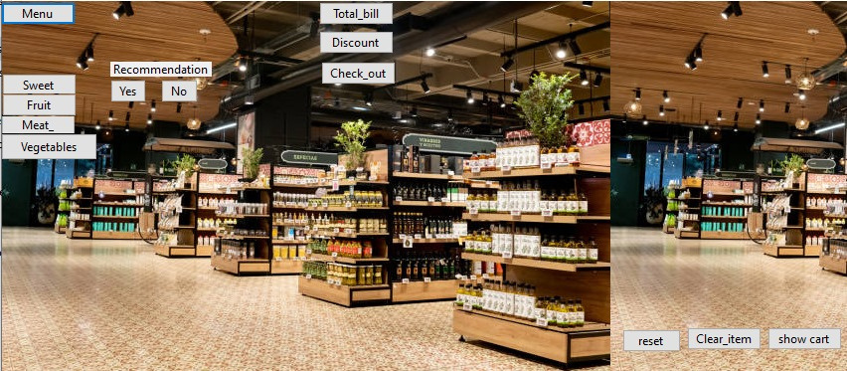
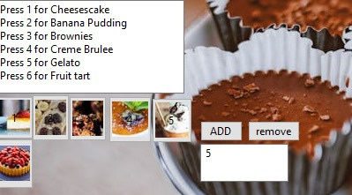
Menu
Other Buttons
1.Sweet
2.Fruit
3.Meat
4.Vegetables
Recommendation
Total Bill
Discount
Check Out
Section Items:
Click Category from Menu
Press Enter
Then Press / Click the item’s image you want to add
Add Items:
Click Item’s image
Click ADD button
Enter amount
Press Enter

Slide 5

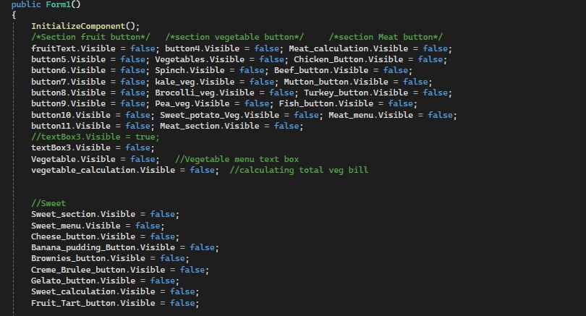
Hide Buttons:
Basically , this code make all others button invisible when except the one that you are currently on .
Make Visibility False.
Backgroung Image Code->

Slide 6

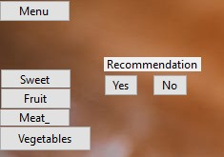
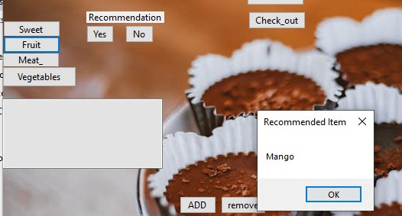
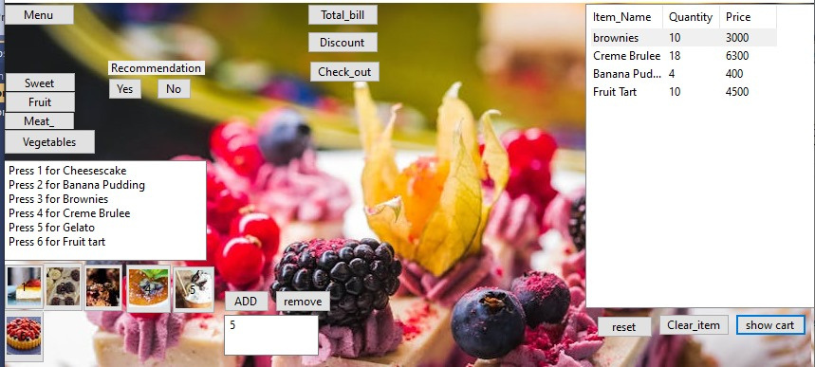
Recommendation Button:
Yes /No
Showing Recommended Item:
In this Example, ‘Mango’
Adding Items to Cart showing Item_name,Quantity and price:
Keep on Adding items from your sections.
Click on “show cart” to view your cart

Slide 7
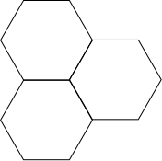
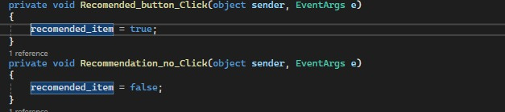

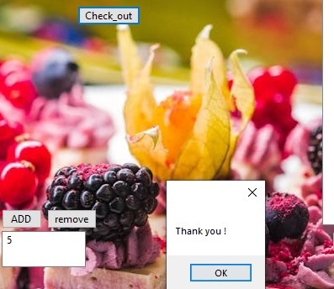
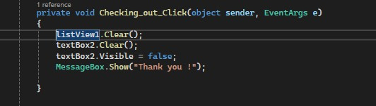
Code & Logic of Recommended Item Button:
Code & Logic of Check Out Button:

Slide 8
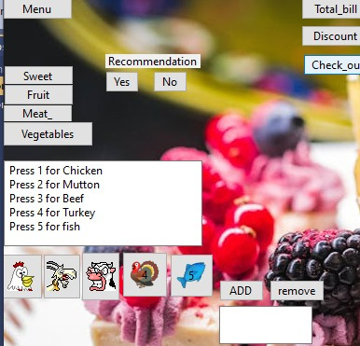
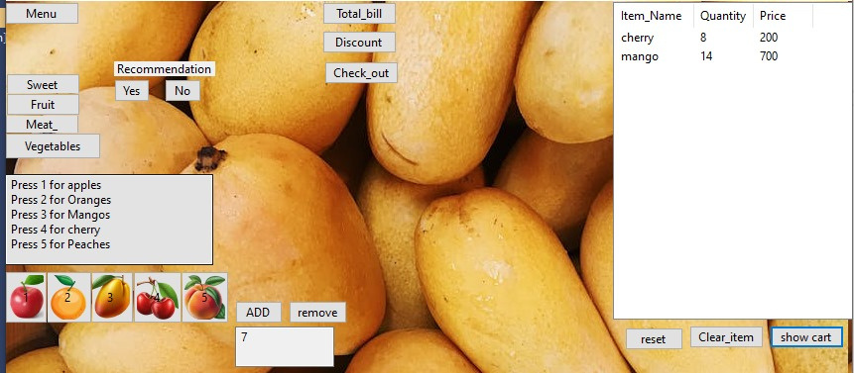
Meat Section :
This section shows the items related to meat category. You can Click,Select,Press Enter and ADD quantity and view your Cart.
Chicken
Mutton
Beef
Turkey
Fish
Fruit Section:
In this example, added 8 items of “cherry” and 14 items of “mango”, which can be viewed in cart.

Slide 9
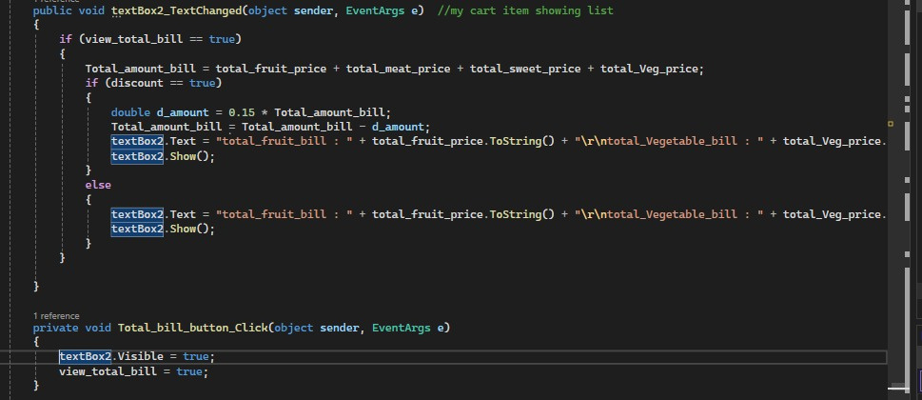
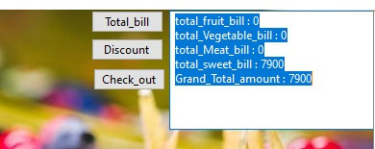
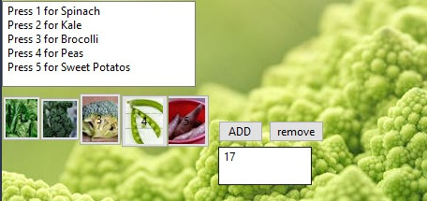
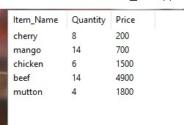
Code & Logic of Total Bill Calculation:
Click on Total Bill Button
Press Enter
View your bill
Items added into the cart from vegetables section.

Slide 10
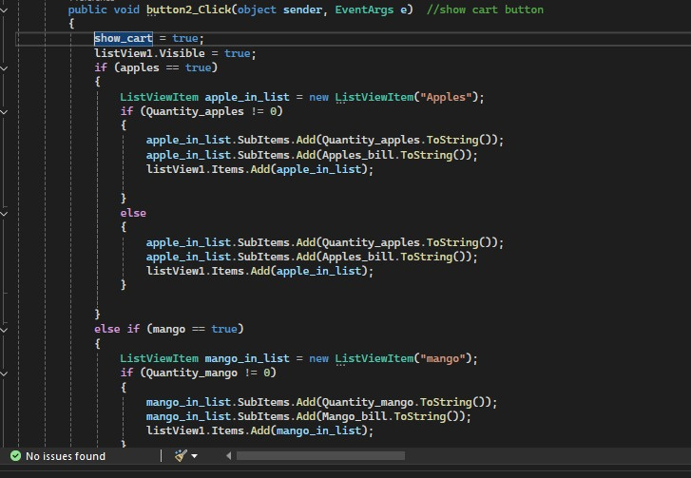
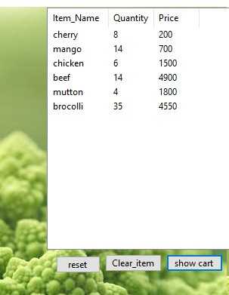
Code & Logic of Show Cart Button:
(that shows the added items of sections)
View Cart

Slide 11

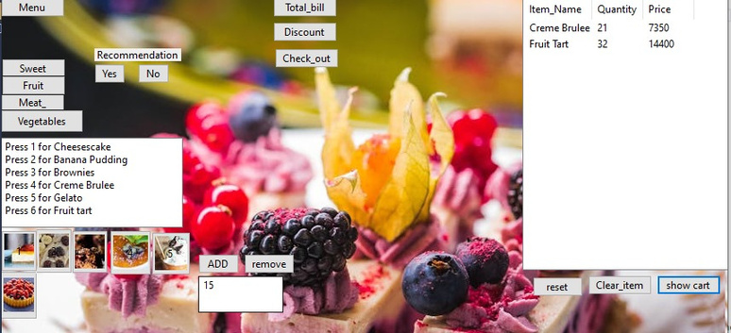
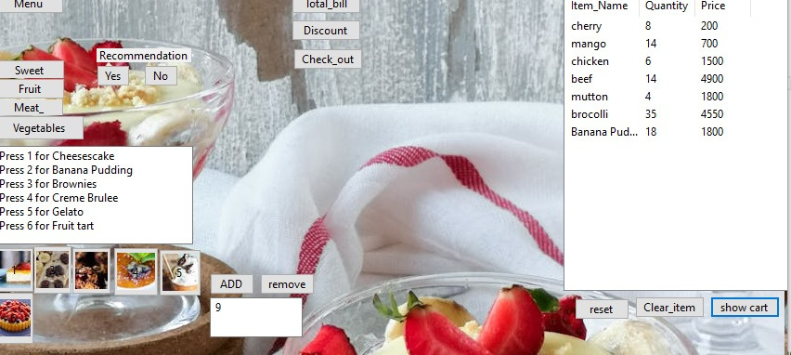
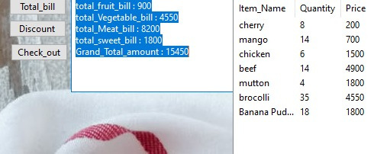
Cart of Sweet Section
Cart of different Sections
Total Bill

Slide 12
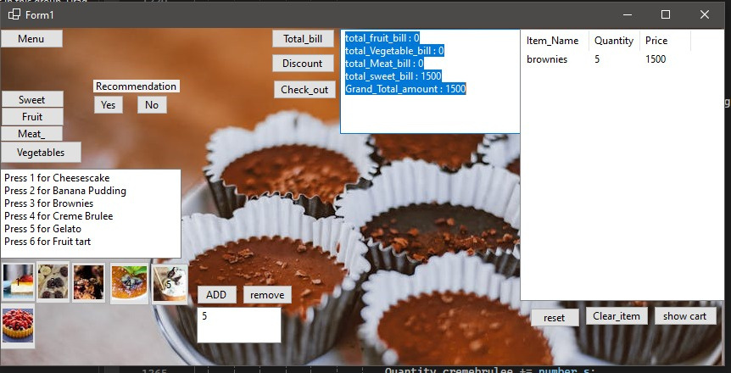
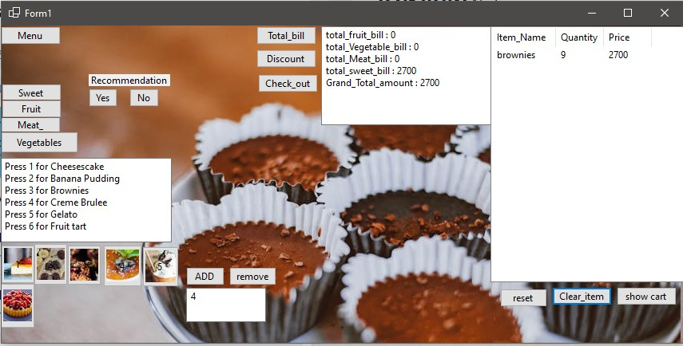
ADD BUTTON:
First , added items and calculated total bill
Updating total bill and cart:
Adding the quantity of item and showing the update in total bill

Slide 13
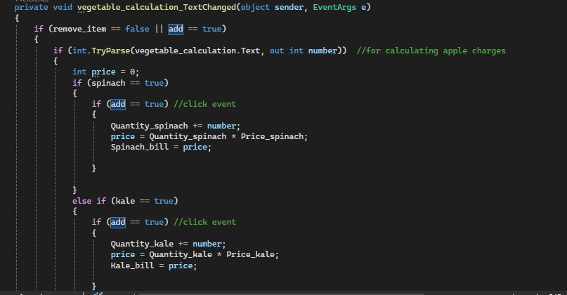

Code & Logic of ADD Cart Button:
(that adds the items from the different sections into the cart)

Slide 14
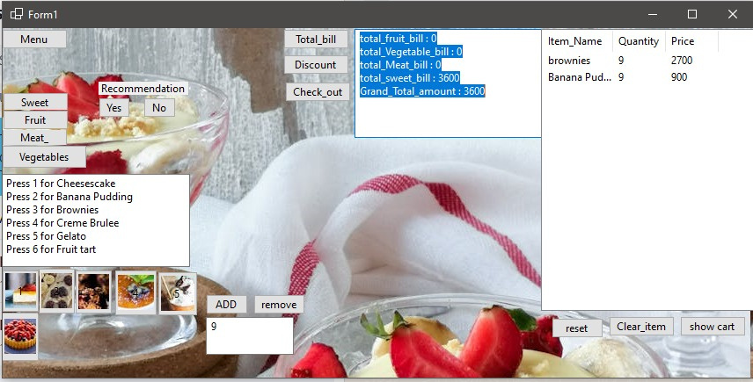
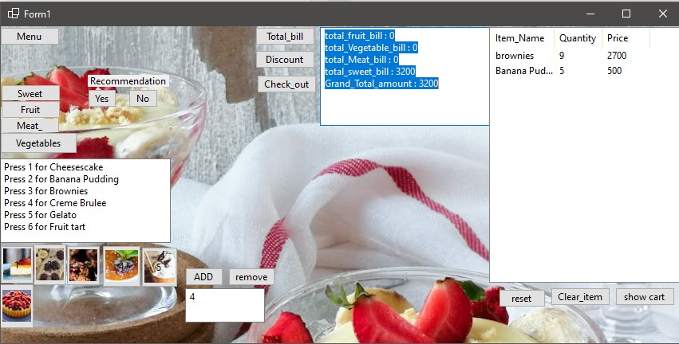
REMOVE BUTTON:
First , added items and calculated total bill
Updating total bill and cart:
Removing the quantity of item and showing the update in total bill.

Slide 15
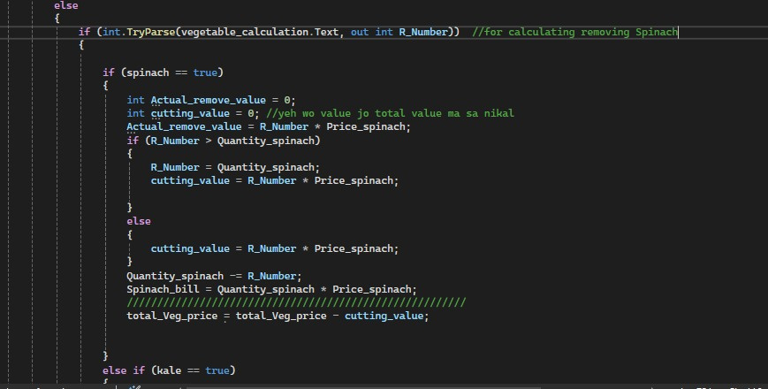

Code & Logic of REMOVE Cart Button:
(that removes the items from the different sections into the cart and update the bill.)

Slide 16
THANK
YOU

